Slide 1
Class 2
The State of Play in International Trade and Trade Policy II:
Other by
Alan V. Deardorff
University of Michigan
2022
PubPol/Econ 541

Slide 2
Announcements
Quiz 1 due Friday midnight.
  Accepted until Saturday midnight with penalty
  Covers material from last Thursday and today only.

Slide 3
Pause for News

Slide 4
State of Play: Other
Outline
  Background from KOM
  Brexit
  Pandemic and Trade
  China Trade Actions
  Russia Sanctions
  Other Disputes and Actions

Slide 5
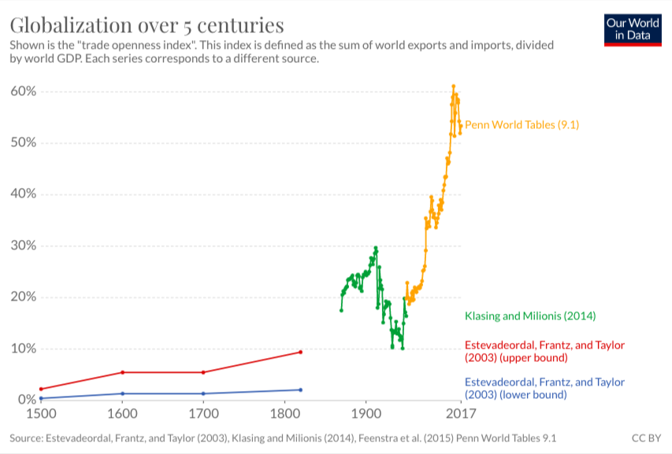
World Trade Growth
Notes:
Our World in Data
https://ourworldindata.org/trade-and-globalization

Slide 6
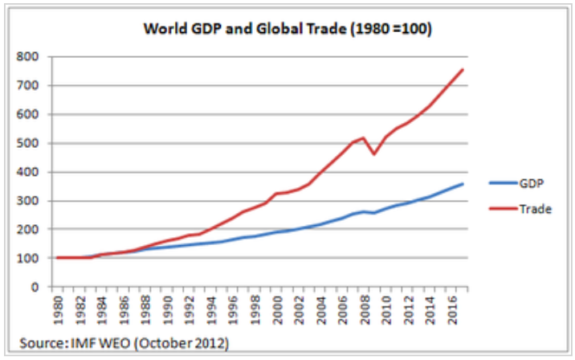
World Trade Growth
Notes:
https://g2reports.weebly.com/reports.html

Slide 7
Pause for Discussion

Slide 8
  Questions from KOM
How much has trade grown? why?
Who gains from trade?
What does trade between two countries depend on?
Why is the gravity model useful?
Do national borders interfere with trade?
Why is trade in services growing?

Slide 9
Brexit
Brexit Timeline
  Jun 23, 2016: Referendum
    UK votes to leave EU
  Mar 29, 2017: EU exit provision triggered
    UK PM initiates 2-year exit process
  2019: Several extensions asked and given
  Jan 31, 2020: UK leaves EU
    Transition period (policies unchanged) thru 2020
  Dec 31, 2020: Transition period ends
Notes:
Walker, Nigel, ” Brexit timeline: events leading to the UK’s exit from the European Union,” House of Commons Library, June 10, 2020.
https://commonslibrary.parliament.uk/research-briefings/cbp-7960/

Slide 10
Brexit
The Brexit Agreement
  Reached Dec 24, 2020
    EU Ambassadors approved Dec 28
    UK MPs approved Dec 30
    Signed Dec 30
    Effective provisionally Jan 1, 2021
    Entered into force May 1, 2021, after ratification
  Title: “Trade and Cooperation Agreement”

Slide 11
Brexit
The Brexit Agreement
  Features:
    Free Trade Agreement for goods, but with rules of origin (no longer customs union)
    Some limited mutual market access for services
  Not included:
    Free movement of persons
    UK subject to European Court of Justice
    UK subject to EU regulations

Slide 12
Brexit
Northern Ireland (N.I.) Protocol
  Part of the Brexit Withdrawal Agreement from Dec 24, 2020
  Avoids hard border between N.I. (part of UK) and Ireland (EU member country) by
    Keeping N.I. in EU customs union
    Adding customs checks, etc., between N.I. and Great Britain (the rest of UK: England, Scotland, Wales)
  Reason: To avoid re-igniting the “Troubles”

Slide 13
Brexit
The N.I. Protocol Is Contentious
  Trade within UK between N.I. and Great Britain is costly and cumbersome
    Must pass through customs checks
    These often include checks for satisfying regulations (health & safety, etc.)
  PM Johnson in June 2022 (before he stepped down) submitted a bill to “rip up” the Protocol

Slide 14
Pause for Discussion

Slide 15
  Questions on Brexit (Kirkegaard)
What UK objectives are mentioned here as having been achieved by the agreement?
What aspects of UK-EU interactions will be adversely affected by the agreement?
What is the relevance of
  “rules of origin”?
  “minimal processing requirements”?

Slide 16
  Questions on Brexit
  (Castle)
What is the most problematic piece of the protocol?
Why did they not just have a normal EU-UK border between Ireland and Northern Ireland?
Why are sausages an issue?

Slide 17
  Questions on Brexit
  (Parker)
What did the Northern Ireland Protocol do, to the extent that you can tell from this?
What does this new law try to do?
What motivates this? Are the people in Northern Ireland unhappy with it?
Who objects to this, and why?
Will the law take effect?

Slide 18
Pandemic and Trade
Cases and deaths
Changes in trade
Changes in trade policies
Notes:
Walker, Nigel, ” Brexit timeline: events leading to the UK’s exit from the European Union,” House of Commons Library, June 10, 2020.
https://commonslibrary.parliament.uk/research-briefings/cbp-7960/

Slide 19
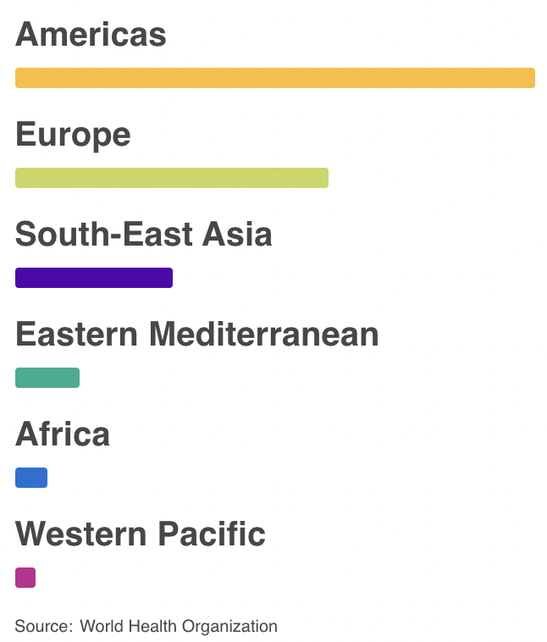
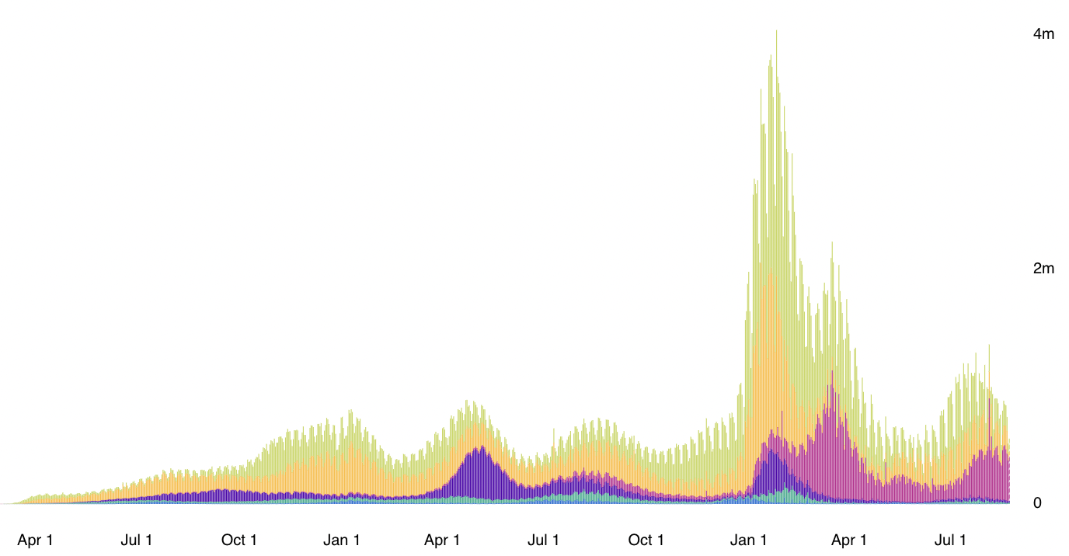
Cases
Daily Confirmed Cases
2020 2021 2022
Source: WHO Coronavirus Disease (COVID-19) Dashboard as of Aug 23, 2022
Notes:
WHO Coronavirus Disease (COVIC-19) Dashboard
https://covid19.who.int/?gclid=CjwKCAiAuoqABhAsEiwAdSkVVNd67qw_hEb4v9v3UxACJd_csZMJl8Yc5UjaAIYt53KJWSQiXZPlRxoCm0kQAvD_BwE

Slide 20
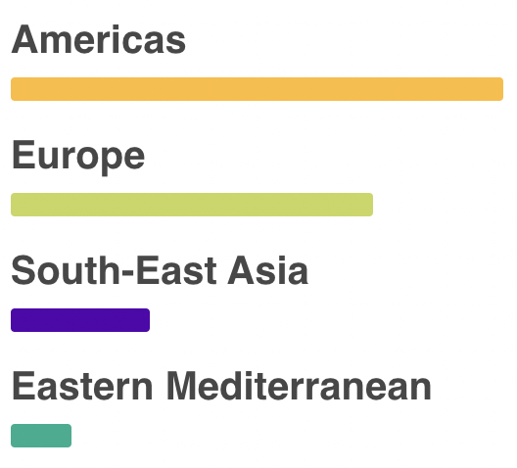
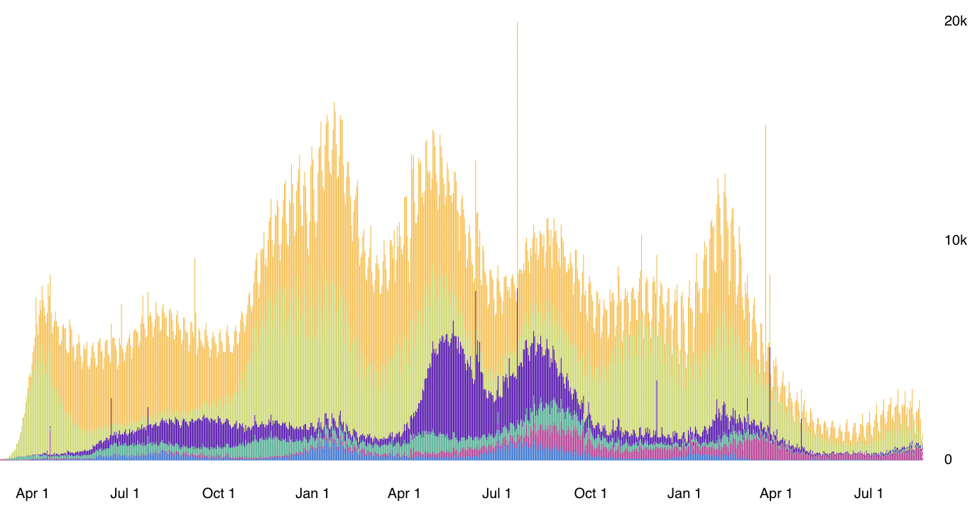
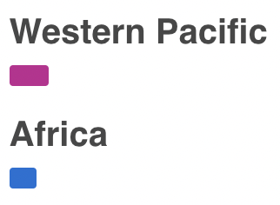
Deaths
Daily Deaths
2020 2021 2022
Source: WHO Coronavirus Disease (COVID-19) Dashboard as of Aug 23, 2022
Notes:
WHO Coronavirus Disease (COVIC-19) Dashboard
https://covid19.who.int/?gclid=CjwKCAiAuoqABhAsEiwAdSkVVNd67qw_hEb4v9v3UxACJd_csZMJl8Yc5UjaAIYt53KJWSQiXZPlRxoCm0kQAvD_BwE

Slide 21
Pandemic and Trade
Global trade dropped abruptly, due to
  Factory shutdowns, first in China, then elsewhere, cutting supply
  Supply chains interrupted, cutting supply even from factories not shut down
  Incomes fell as jobs were lost, cutting demand
  Some shipping, and most air transport, stopped due to virus (much normally rides with passengers)
Notes:
Walker, Nigel, ” Brexit timeline: events leading to the UK’s exit from the European Union,” House of Commons Library, June 10, 2020.
https://commonslibrary.parliament.uk/research-briefings/cbp-7960/

Slide 22
Pandemic and Trade
Trade then recovered just as abruptly
  Much faster than after 2008 financial crisis
Trade in goods then set records in 2021
Trade in services resumed growth later, just recently surpassing pre-pandemic levels
Notes:
Walker, Nigel, ” Brexit timeline: events leading to the UK’s exit from the European Union,” House of Commons Library, June 10, 2020.
https://commonslibrary.parliament.uk/research-briefings/cbp-7960/

Slide 23
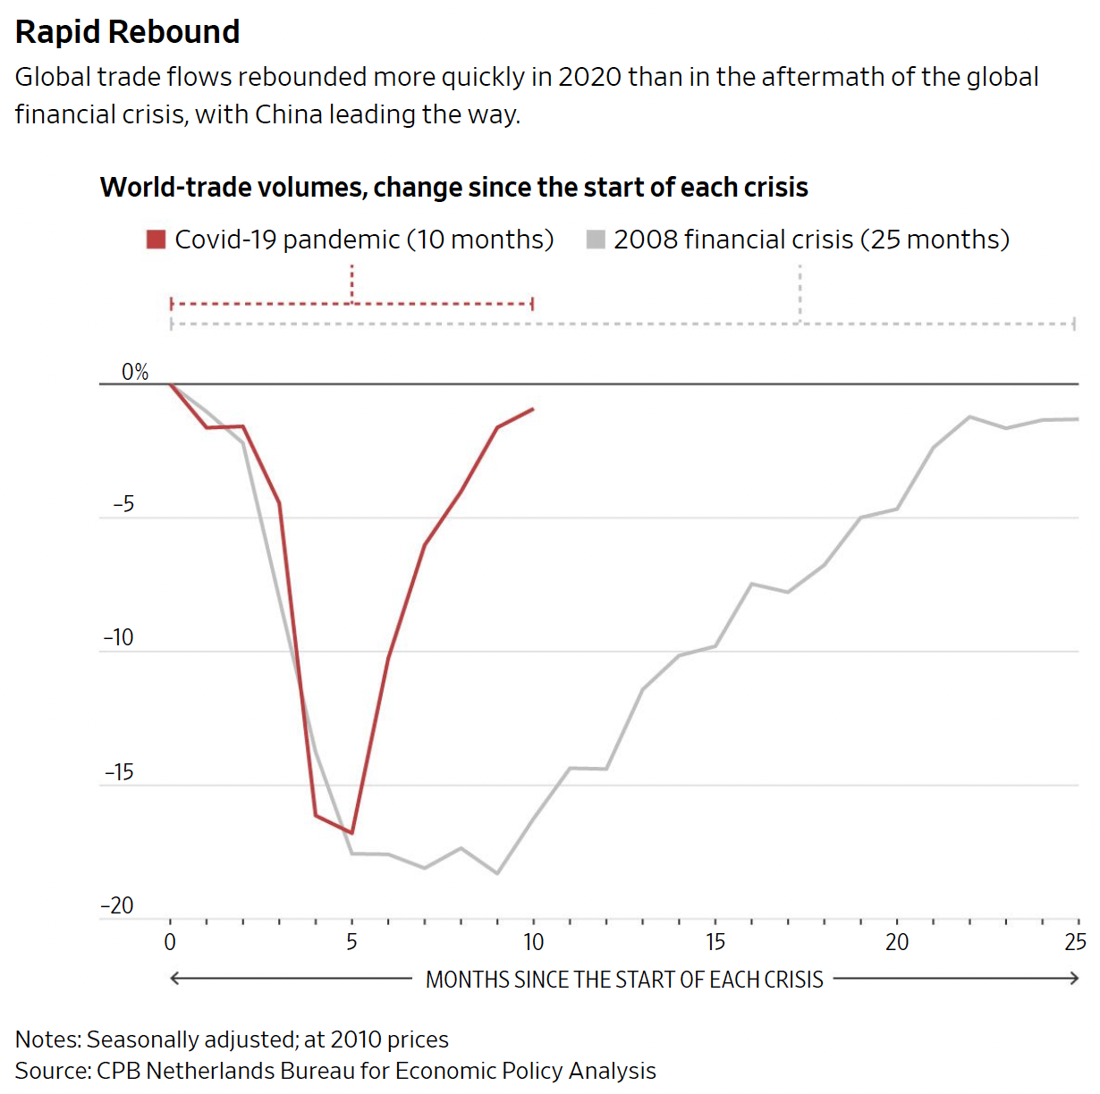
Hannon, WSJ, 2/25/21.
Notes:
Hannon, Paul, "Global Trade Roars Back From Depths of Covid-19 Pandemic", Wall Street Journal,, February 25, 2021.

Slide 24
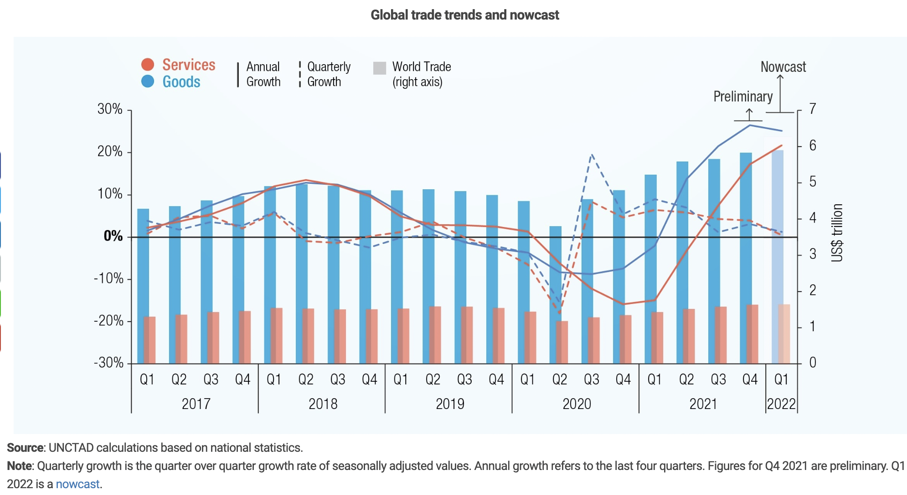
Pandemic drop and recovery
Source: UNCTAD, February 17, 2022
Notes:
UNCTAD, “Global trade hits record high of $28.5 trillion in 2021, but likely to be subdued in 2022,” 17 February 2022.
https://unctad.org/news/global-trade-hits-record-high-285-trillion-2021-likely-be-subdued-2022

Slide 25
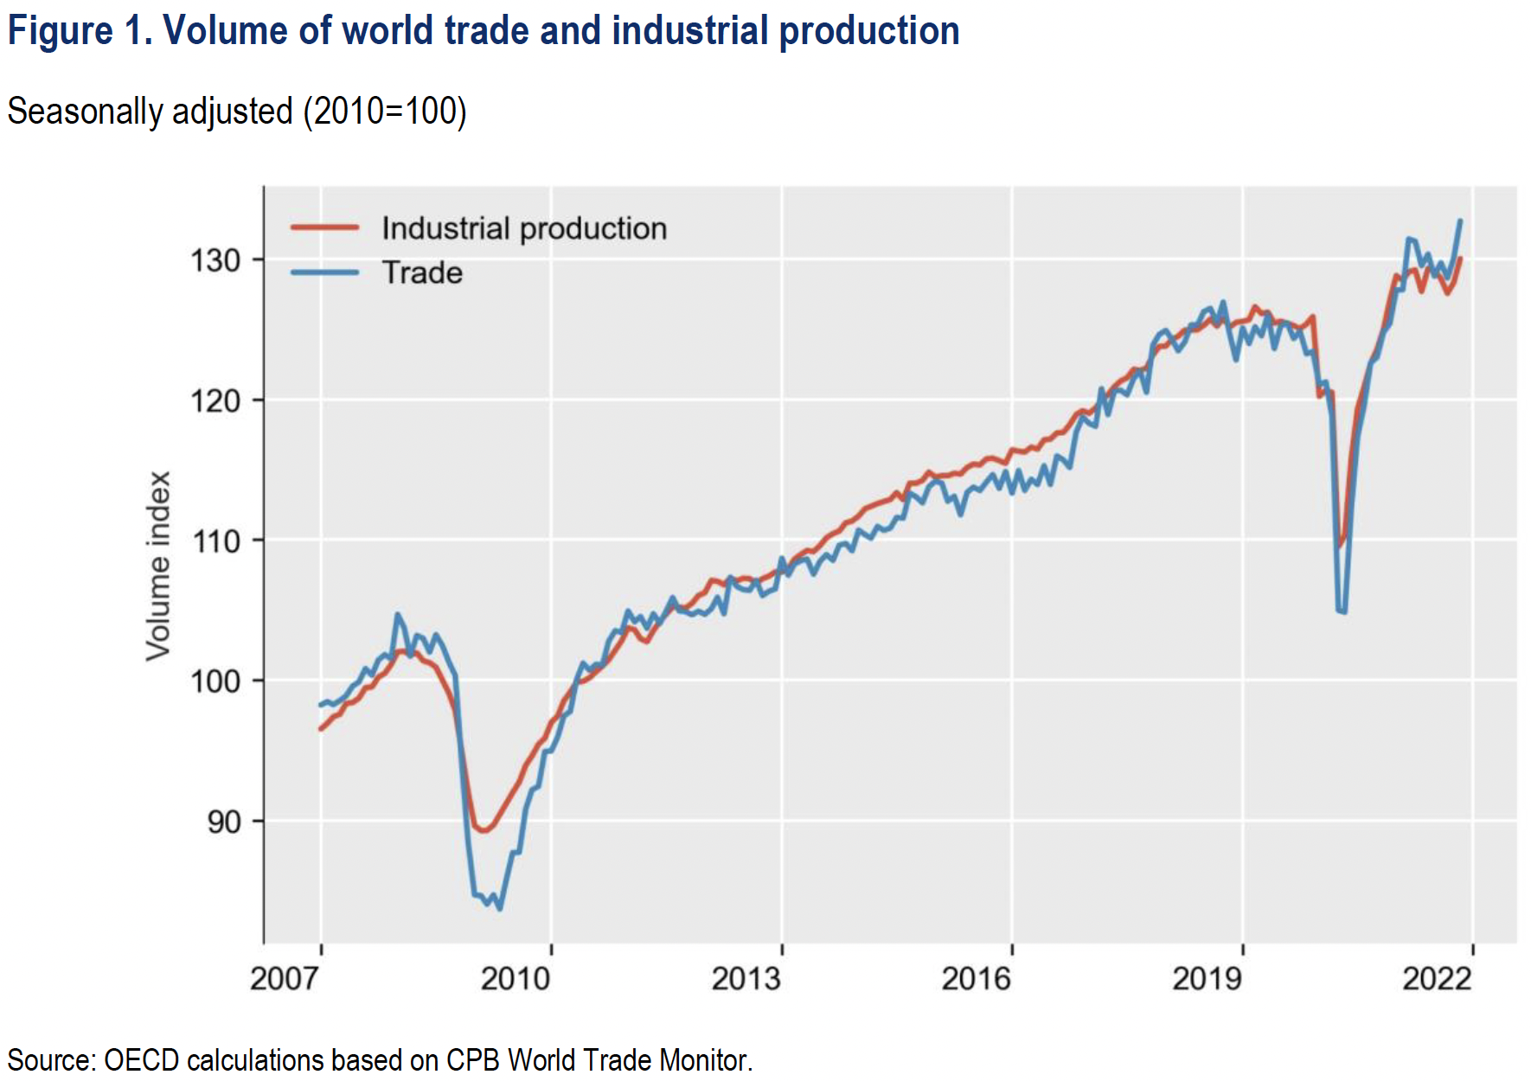
Notes:
OECD, “International trade during the COVID-19 pandemic: Big shifts and uncertainty,” March 20, 2022. [13p]. https://read.oecd-ilibrary.org/view/?ref=1129_1129345-casormobh7&title=International-trade-during-the-COVID-19-pandemic

Slide 26
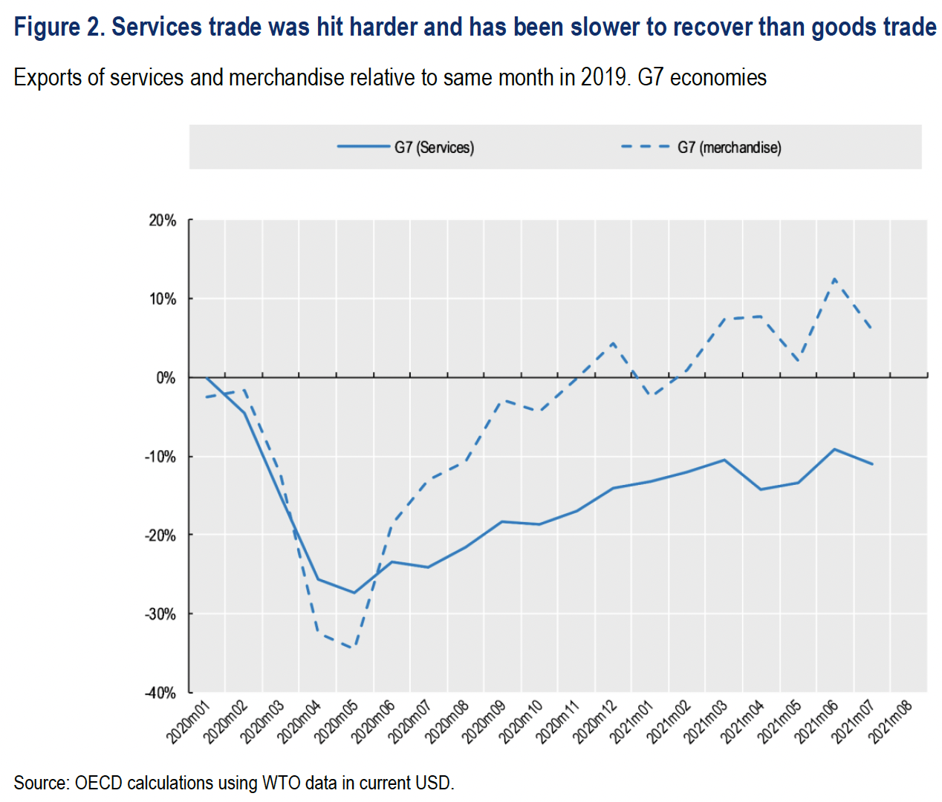
Notes:
OECD, “International trade during the COVID-19 pandemic: Big shifts and uncertainty,” March 20, 2022. [13p]. https://read.oecd-ilibrary.org/view/?ref=1129_1129345-casormobh7&title=International-trade-during-the-COVID-19-pandemic

Slide 27
Pandemic and Trade
Effects on policies
  Export bans to keep in tools to fight virus
  Import bans to keep out virus
  Tariff reductions (just a few, to help needed access, mostly on medical supplies)
  A group of countries committed to “keeping supply and trade links open” for “essential goods, especially medical supplies”
Notes:
Walker, Nigel, ” Brexit timeline: events leading to the UK’s exit from the European Union,” House of Commons Library, June 10, 2020.
https://commonslibrary.parliament.uk/research-briefings/cbp-7960/

Slide 28
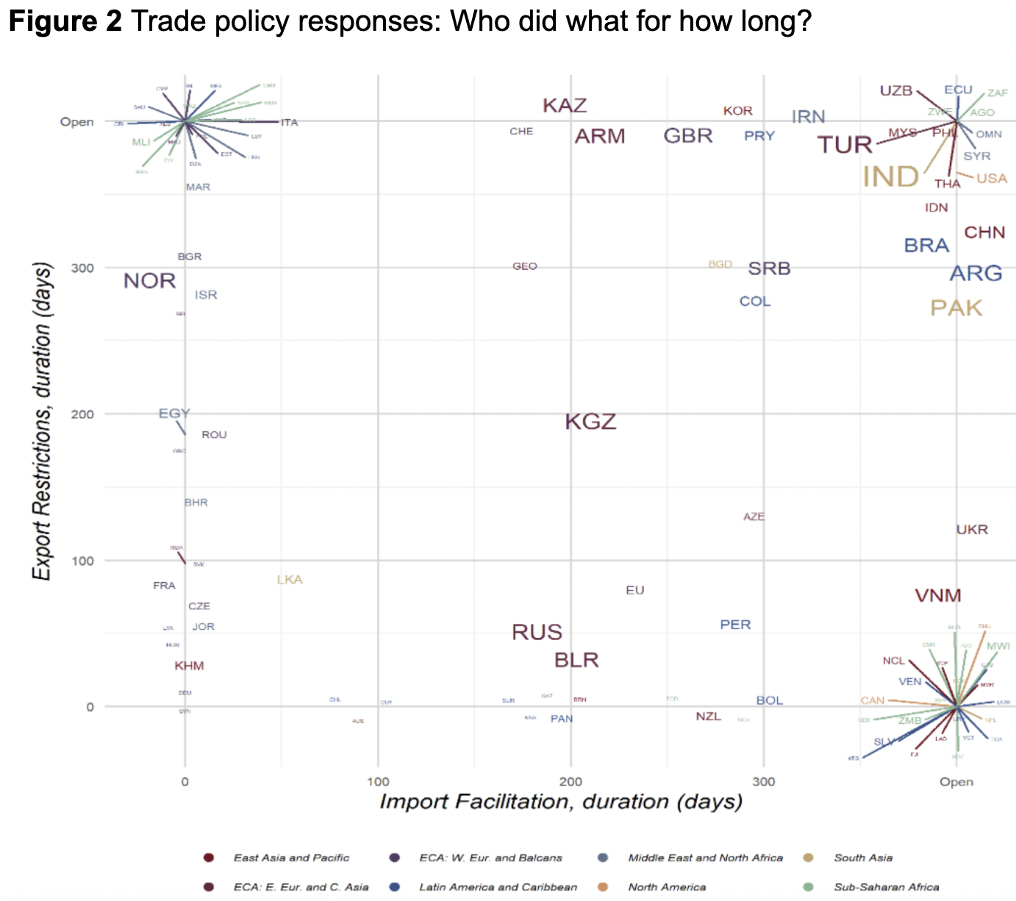
Countries with only export restriction, extending beyond 2020
USA
Inc. ITL
Inc. IND
Notes: Coloured lines point to the names of countries located in the same space of a graph. Countries are displayed in terms of the duration (in days) of the longest period with at least one active import liberalization measure (horizontal axis) and at least one active export restriction (vertical axis). The value "Open" at the end of each axis identifies measures without an end date or that extend beyond December 2020. The font size of each country code is proportional to the total number of measures implemented; colours identify the associated world region.
Countries with both import facilitation and export restriction, extending beyond 2020
CHN
Inc. CAN
Countries with only import facilitation, extending beyond 2020
Source: Evenett et al.
Notes:
Evenett, Simon, Matteo Fiorini, Johannes Fritz, Bernard Hoekman, Piotr Lukaszuk, Nadia Rocha,Michele Ruta, Filippo Santi, Anirudh Shingal, “Trade policy responses to the COVID-19 pandemic: Evidence from a new dataset,” VOXEU, December 11, 2020.
https://voxeu.org/article/trade-policy-responses-covid-19-pandemic-new-dataset

Slide 29
Pandemic and Trade
Other effects
  Seamen were stranded on board
  Countries raced to be first with vaccine
  Increased desire for self-sufficiency
  Concerned about reliance on China for PPE
  Trade in education suffered
  Price of oil became negative
  Countries with vaccines restricted exports
Notes:
Walker, Nigel, ” Brexit timeline: events leading to the UK’s exit from the European Union,” House of Commons Library, June 10, 2020.
https://commonslibrary.parliament.uk/research-briefings/cbp-7960/

Slide 30
Pause for Discussion

Slide 31
  Questions on Pandemic (OECD)
How did the response of trade during the pandemic compare to that of the earlier global financial crisis?
In what products did trade actually grow?
What happened to the cost of ocean shipping, and why?

Slide 32
  Questions on Pandemic
  (GDPC)
This is a summary of a larger report by whom? What countries did it study?
What sorts of measures did the countries use during the pandemic?
Which of these countries intervened most, and which least?
What conclusion does the report draw about the role of international rules?

Slide 33
China Trade Actions
China has banned imports of meat several times over health concerns
  2020: Meats from Brazil over concerns about Covid-19 cases in processing plants
  2020: beef from Ireland after 1 mad-cow case
  Sep 2021: beef from Brazil after 2 mad-cow cases.
  Sep 2021: beef from cattle under 30 months from UK after 1 mad-cow case
Notes:
Walker, Nigel, ” Brexit timeline: events leading to the UK’s exit from the European Union,” House of Commons Library, June 10, 2020.
https://commonslibrary.parliament.uk/research-briefings/cbp-7960/

Slide 34
China Trade Actions
China halted trade with Lithuania in response to Lithuania allowing Taiwan to set up an office there representing “Taiwan” rather than “Taipei”
  Action extends to goods from other countries with parts from Lithuania
Unprecedented? No.
  Halted salmon from Norway in 2010
  Blocked agricultural imports from Australia in 2019
Notes:
Walker, Nigel, ” Brexit timeline: events leading to the UK’s exit from the European Union,” House of Commons Library, June 10, 2020.
https://commonslibrary.parliament.uk/research-briefings/cbp-7960/

Slide 35
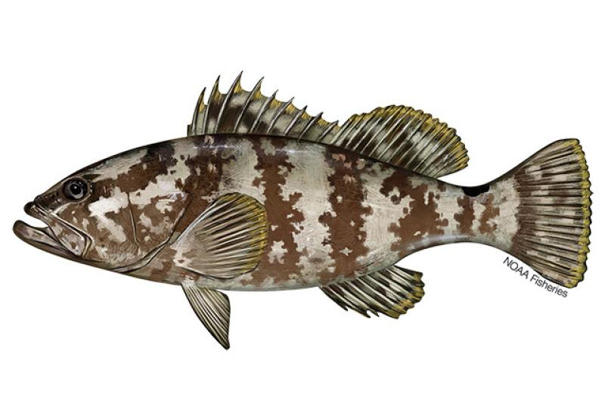
China Trade Actions
In June, China banned a fish, grouper, from Taiwan saying it was tainted by chemicals and drugs.
Last year China banned pineapples and wax apples from Taiwan saying they brought in pests.
Notes:
Walker, Nigel, ” Brexit timeline: events leading to the UK’s exit from the European Union,” House of Commons Library, June 10, 2020.
https://commonslibrary.parliament.uk/research-briefings/cbp-7960/

Slide 36
China Trade Actions
In August, in response to US House Speaker Nancy Pelosi visiting Taiwan
China
  Blocked imports from hundreds of Taiwanese food producers
  Suspended exports of natural sand
This is a “huge expansion” compared to China’s earlier uses of economic levers
Notes:
Walker, Nigel, ” Brexit timeline: events leading to the UK’s exit from the European Union,” House of Commons Library, June 10, 2020.
https://commonslibrary.parliament.uk/research-briefings/cbp-7960/

Slide 37
Pause for Discussion

Slide 38
  Questions on
  China Trade Actions
Rade
Is the blockage said by China to be officially due to the Pelosi visit?
Is sand important?
Does Taiwan’s ruling DPP party favor independence from China?

Slide 39
Russia Sanctions
Russia’s invasion of Ukraine on Feb 24, 2022 prompted economic responses
  Economic sanctions by governments
    Financial linkages
    Trade
  Private companies stopped dealing with Russia
Notes:
Walker, Nigel, ” Brexit timeline: events leading to the UK’s exit from the European Union,” House of Commons Library, June 10, 2020.
https://commonslibrary.parliament.uk/research-briefings/cbp-7960/

Slide 40
Russia Sanctions, Gov’t
Financial sanctions by US, EU, UK, and others
  Frozen foreign-held assets of individuals, Putin and dozens of others
  Restrictions on Russia’s Central Bank’s use of international reserves
  Several Russian banks removed from the Swift international payments system
  Cut off many Russian banks from transactions and operations
  Long list of Russian companies banned or restricted
  Possible restrictions on Russia borrowing from IMF and World Bank
Notes:
Walker, Nigel, ” Brexit timeline: events leading to the UK’s exit from the European Union,” House of Commons Library, June 10, 2020.
https://commonslibrary.parliament.uk/research-briefings/cbp-7960/

Slide 41
Russia Sanctions, Gov’t
Trade sanctions by governments
  Oil and other energy
    Germany puts Nord Stream 2 gas pipeline on hold
    US bans from Russia
    UK to phase out Russian oil by end of 2022
    EU to become independent from Russia by 2030
  EU bans steel imports from Russia
  US restricts exports to Russia, especially technology and military; later also to Belarus; later also luxury goods
  EU and UK impose export restrictions similar to US
  Ban on Russian air carriers by Canada, EU, US, UK
  G-7 to revoke Russia’s most favored nation status
    Permits them to raise tariffs on Russian goods
Notes:
Walker, Nigel, ” Brexit timeline: events leading to the UK’s exit from the European Union,” House of Commons Library, June 10, 2020.
https://commonslibrary.parliament.uk/research-briefings/cbp-7960/

Slide 42
Russia Sanctions, Gov’t
Countries
Australia | Iceland | Singapore
Bahamas | Italy | Switzerland
Canada | Japan | Taiwan
EU | New Zealand | UK
Finland | Norway | US
France | Poland
Germany | S Korea
Source: Funakoshi et al, “Updated July 7, 2022” but includes from July 29
Notes:
Funakoshi, Minami, Hugh Lawson, and Kannaki Deka, “Tracking sanctions against Russia,” Reuters, March 9, 2022, updated July 7, 2022..
https://graphics.reuters.com/UKRAINE-CRISIS/SANCTIONS/byvrjenzmve/

Slide 43
Russia Sanctions, Gov’t
Russian Targets
Airlines | 2 |  | Generals | 1 |  | Oligarchs | 23
Banks | 9 |  | Government | 1 |  | Retail | 1
Cnt. Banks | 5 |  | Lawmakers | 2 |  | Ships | 5
Commodity | 1 |  | Lux. goods | 1 |  | Sv wlth fnd | 1
Companies | 19 |  | Media | 2 |  | Tax service | 1
Economy | 3 |  | Mil. Comps. | 14 |  | Tech | 1
Entities | 3 |  | Mining | 2 |  | Transit | 1
Finance | 1 |  | Oil | 2
Gas | 1 |  | Oil imports | 6
Source: Funakoshi et al, “Updated July 7, 2022” but includes from July 29
Notes:
Funakoshi, Minami, Hugh Lawson, and Kannaki Deka, “Tracking sanctions against Russia,” Reuters, March 9, 2022, updated July 7, 2022..
https://graphics.reuters.com/UKRAINE-CRISIS/SANCTIONS/byvrjenzmve/

Slide 44
Russia Sanctions, Gov’t
Countries announcing they will not use sanctions against Russia:
NOT using sanctions
India | Feb 24
Mexico | Mar 1
Brazil | Mar 1
China | Mar 2
Argentina | Mar 4
Indonesia | Mar 9
Turkey | Mar 13
S Africa | Mar 17
Serbia | Apr 21
Source: Bown
Notes:
Bown, Chad P. “Russia's war on Ukraine: A sanctions timeline,” Realtime Economic Issues Watch, Peterson Institute for International Economics, March 14, 20202, last updated July 18, 2022. [4p]
https://www.piie.com/blogs/realtime-economic-issues-watch/russias-war-ukraine-sanctions-timeline

Slide 45
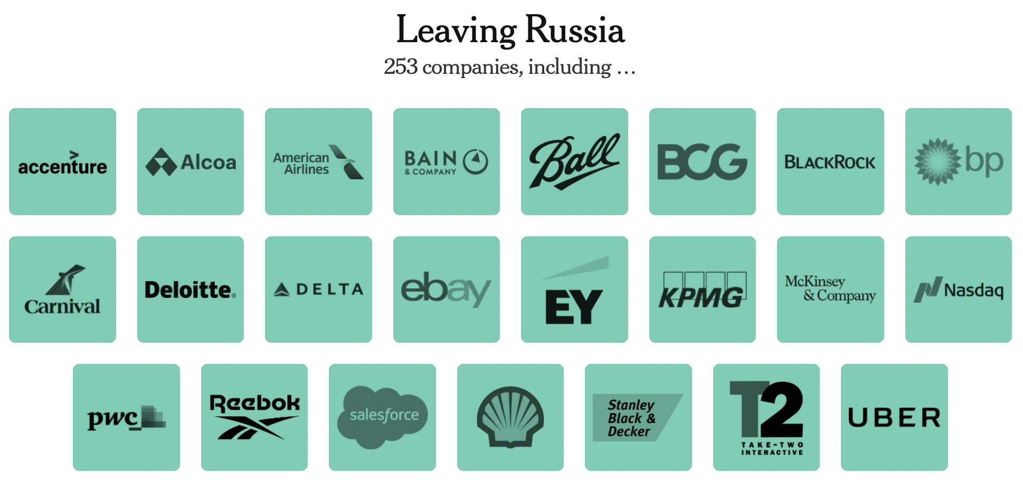
Russia Sanctions, Private
Source: New York Times, April 7, 2022
Notes:
Sonnenfeld, Jeffrey and Steven Tan, “Some of the Biggest Brands Are Leaving Russia. Others Just Can’t Quit Putin. Here’s a List.” New York Times, April 7, 2022.
https://www.nytimes.com/interactive/2022/04/07/opinion/companies-ukraine-boycott.html

Slide 46
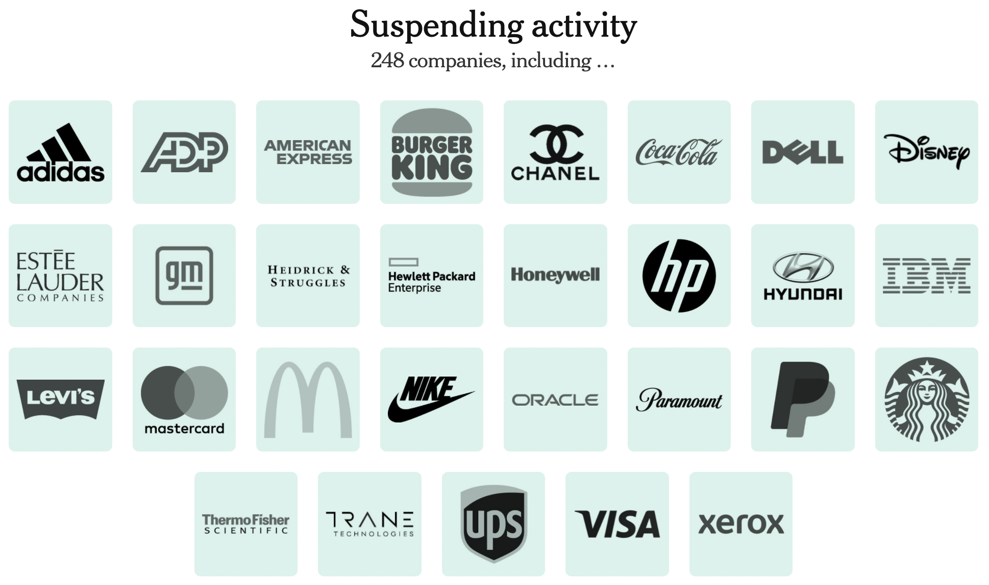
Russia Sanctions, Private
Sold all stores May 20. Stores will operate under new brand.
Source: New York Times, April 7, 2022
Notes:
Sonnenfeld, Jeffrey and Steven Tan, “Some of the Biggest Brands Are Leaving Russia. Others Just Can’t Quit Putin. Here’s a List.” New York Times, April 7, 2022.
https://www.nytimes.com/interactive/2022/04/07/opinion/companies-ukraine-boycott.html

Slide 47
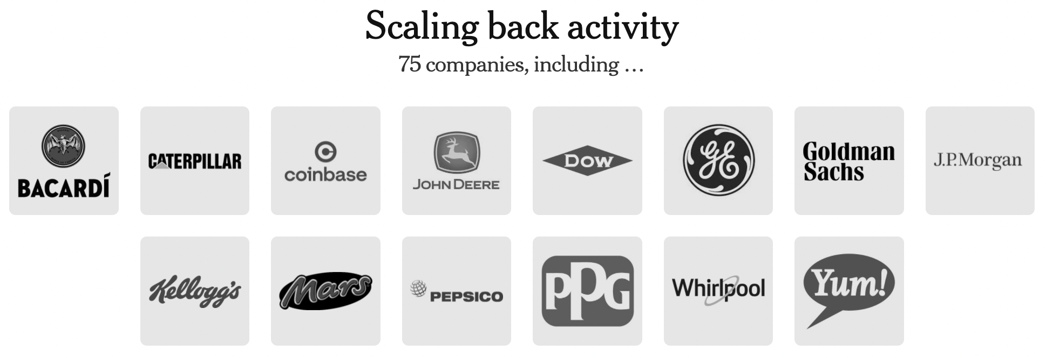
Russia Sanctions, Private
Source: New York Times, April 7, 2022
Notes:
Sonnenfeld, Jeffrey and Steven Tan, “Some of the Biggest Brands Are Leaving Russia. Others Just Can’t Quit Putin. Here’s a List.” New York Times, April 7, 2022.
https://www.nytimes.com/interactive/2022/04/07/opinion/companies-ukraine-boycott.html

Slide 48
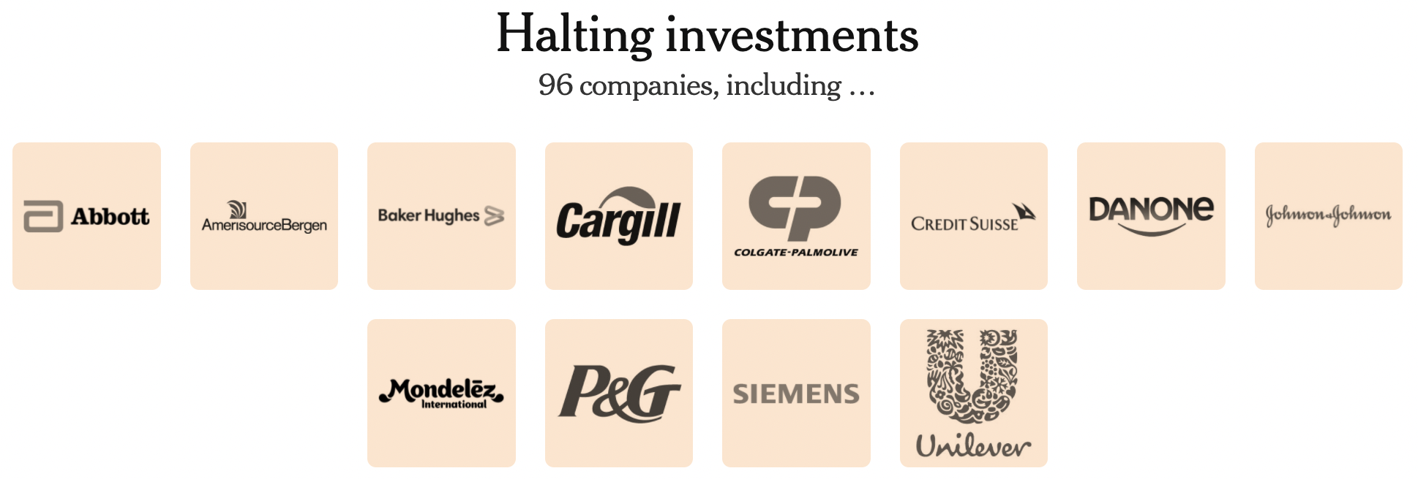
Russia Sanctions, Private
Source: New York Times, April 7, 2022
Notes:
Sonnenfeld, Jeffrey and Steven Tan, “Some of the Biggest Brands Are Leaving Russia. Others Just Can’t Quit Putin. Here’s a List.” New York Times, April 7, 2022.
https://www.nytimes.com/interactive/2022/04/07/opinion/companies-ukraine-boycott.html

Slide 49
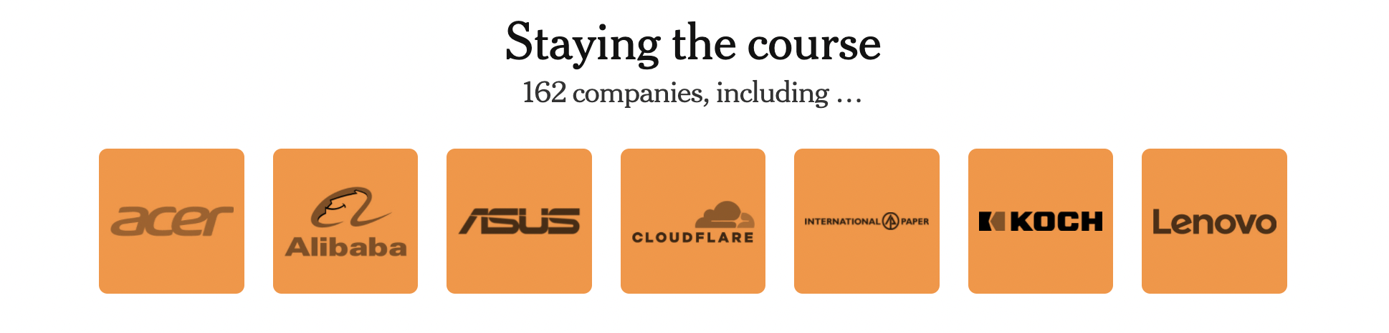
Russia Sanctions, Private
Source: New York Times, April 7, 2022
Notes:
Sonnenfeld, Jeffrey and Steven Tan, “Some of the Biggest Brands Are Leaving Russia. Others Just Can’t Quit Putin. Here’s a List.” New York Times, April 7, 2022.
https://www.nytimes.com/interactive/2022/04/07/opinion/companies-ukraine-boycott.html

Slide 50
Pause for Discussion

Slide 51
  Questions on
  Russia Sanctions
Rade
Are sanctions reported by any poor countries or from Africa or Latin America?
What are the most common targets of sanctions?
How useful did you find the interactive timeline on the Bown site?

Slide 52
Other Disputes and Actions
Disputes
  IPEF
  Solar Panels
  Baby Formula
  Digital Services Tax
  Avocados
  Softwood Lumber
Notes:
Walker, Nigel, ” Brexit timeline: events leading to the UK’s exit from the European Union,” House of Commons Library, June 10, 2020.
https://commonslibrary.parliament.uk/research-briefings/cbp-7960/

Slide 53
Pause for Discussion

Slide 54
  Questions on Other:
  Economist on IPEF
How much will the IPEF cut tariffs? Why?
What are the “4 pillars” of the IPEF?
Though not mentioned in those 4 pillars, what are some of the topics that this will address?
Why does the Economist not view this as “too vague to amount to anything”?

Slide 55
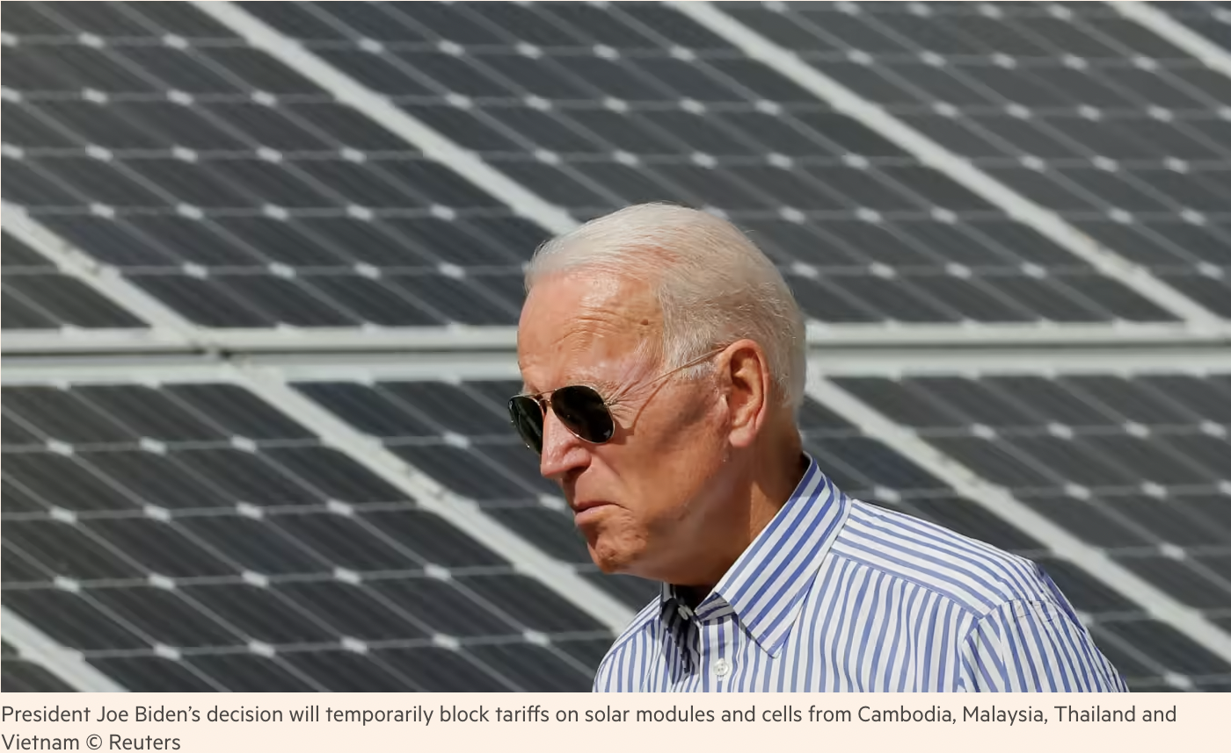
Solar Panels
Notes:
https://www.ft.com/content/b7ec1ce6-42f4-4bd9-841a-02c175d2b4b0

Slide 56
  Questions on Other:
  Politi & Brower on Solar Panels
Why did we have the tariffs on solar panels that Biden is suspending?
Against what countries and for how long is Biden suspending the tariffs?
Why might Biden’s move be subject to legal action?
What other action has Biden taken to shift supplies of solar panels to the US?

Slide 57
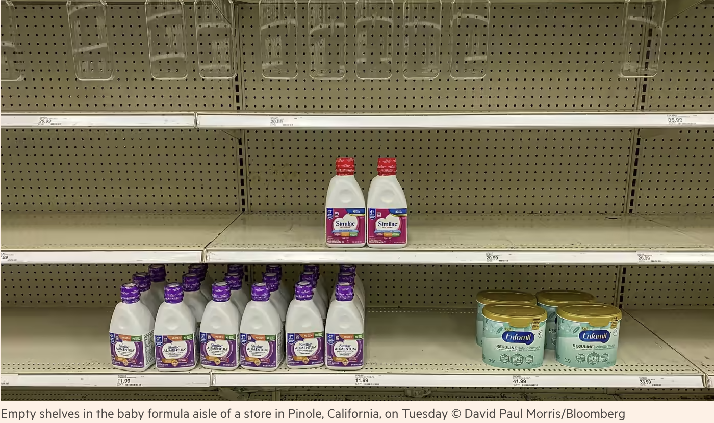
Baby Formula Shortage
Notes:
https://www.ft.com/content/67a769ee-ecee-4c3d-8e60-4417bf2ef7df

Slide 58
  Questions on Other:
  Baby Formula Shortage
Masters:
What is said here to have contributed to the shortage?
Why wasn’t the shortage immediately made up for with imports?
WSJ Editorial:
What did Biden do about it?
What does this editorial view as the real problems?

Slide 59

Digital Services Tax

Slide 60
  Questions on Other:
  Agyemang on Digital Service Tax
What are digital services taxes, and who is mentioned here as having introduced them?
What is the tax overhaul “orchestrated” by the OECD, and what would it do?
Who agreed to the global deal, and who has yet to ratify it?
What is the new agreement mentioned here?
In return, what is the US doing?

Slide 61
  Questions on Other:
  Hayashi on Digital Service Tax
What are the details of Canada’s proposed tax?
Under what US law is the US investigating the digital tax?
What, if any, is the connection of this digital services tax with the OECD global tax agreement?

Slide 62
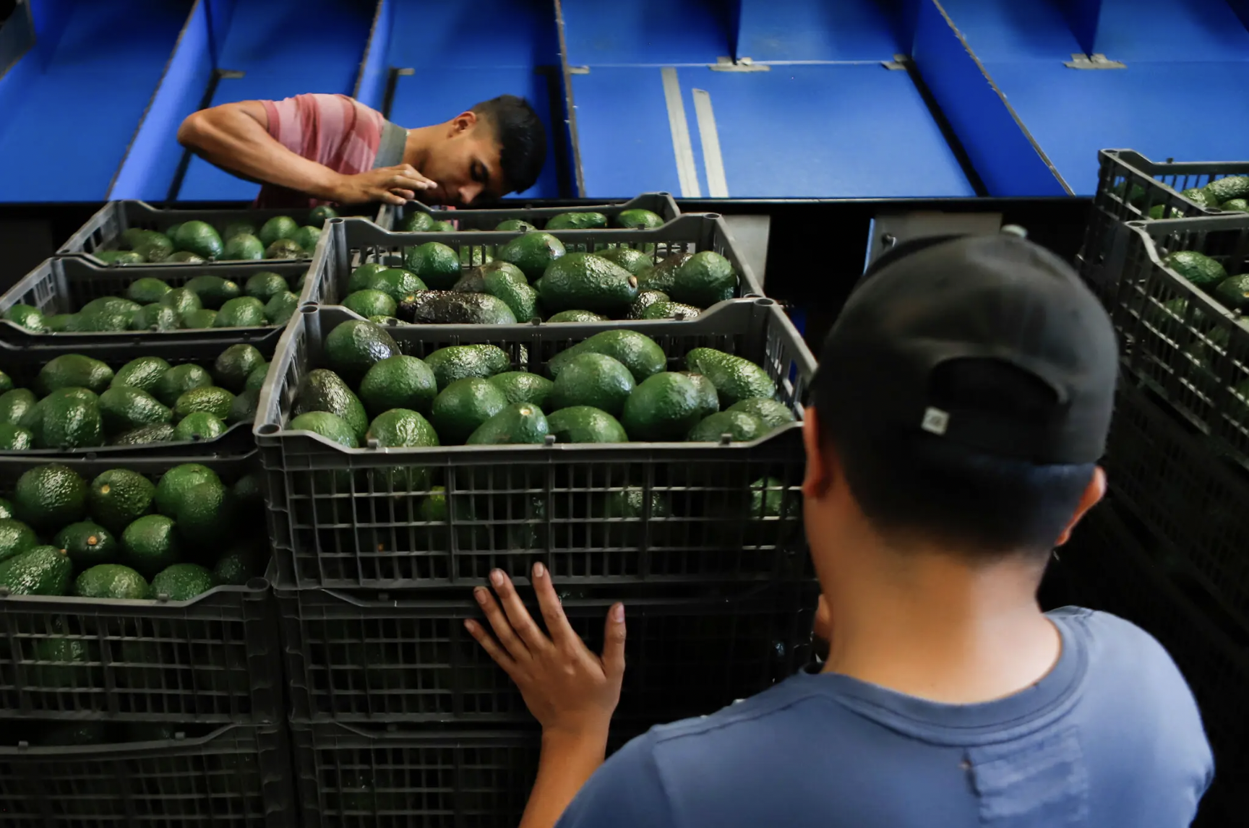
Avocado Ban
Notes:
https://www.nytimes.com/2022/02/19/business/mexico-avocado-ban-lifted.html

Slide 63
  Questions on Other:
  Medina on Avocado Ban
What was the reason for the ban?
How long did it last?
How was it resolved?
Can you tell what is the value of US imports of avocados from Mexico, and from what part of Mexico?
What do drug cartels have to do with this?

Slide 64

Softwood Lumber

Slide 65
  Questions on Other:
  WSJ on Softwood Lumber
Does this say what the legal basis for US tariffs on Canadian lumber is?
Why is the timing of this considered bad?
Could US production meet US demand if there were no imports?

